Slide 1

Algorithms Project 3rd year (Doctor Patient Project)
Team member
Mohamed Yasser
Shrouk Nasser
Samuel Adeal

Slide 2

Introduction
Our project allows the doctor, who belongs to only one department, to manage his data in the system, i.e. appointments between him and his patients and add or delete medications in them.
It allows the patient to see his appointments and to view or scan them. It is possible to register the patient in an unavailable section, meaning there are no available doctors, as the doctor is available if the number of appointments (patients) he is responsible for is less than or equal to 10, and he becomes on the waiting list For this section or delete an appointment from the

Slide 3
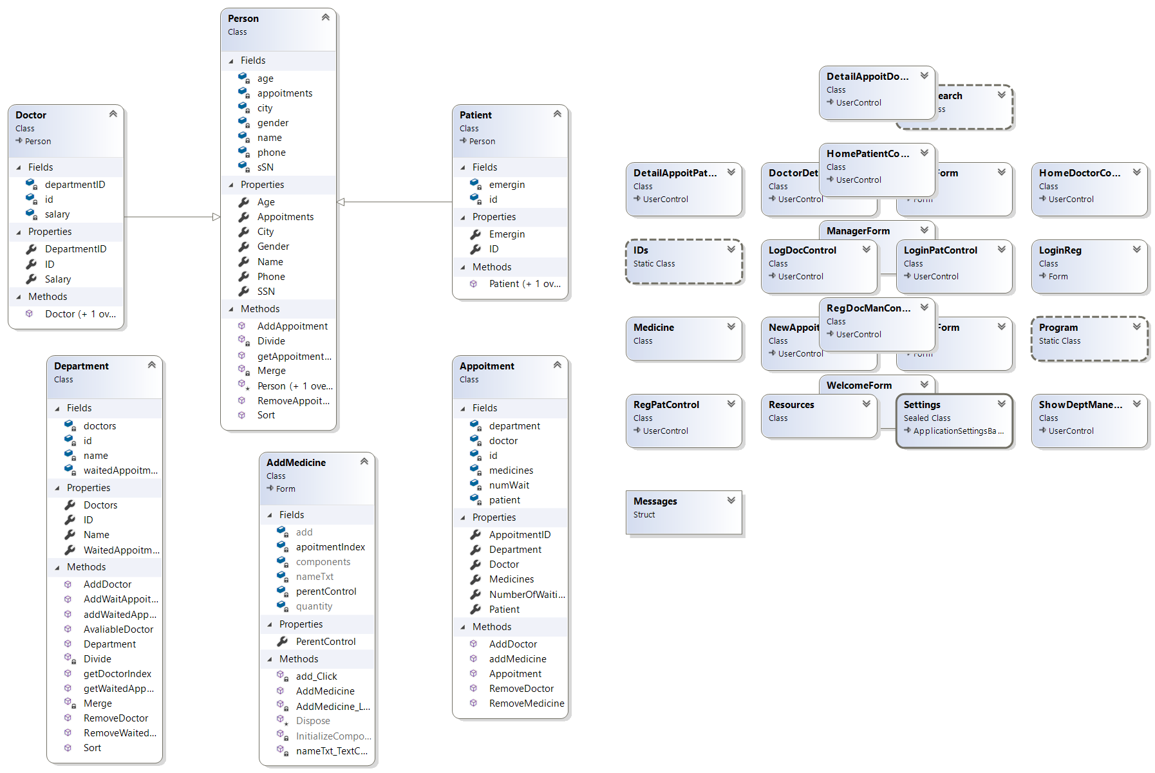
Class Diagram

Slide 4

Algorithms Used
Binary Search
Merge Sort

Slide 5
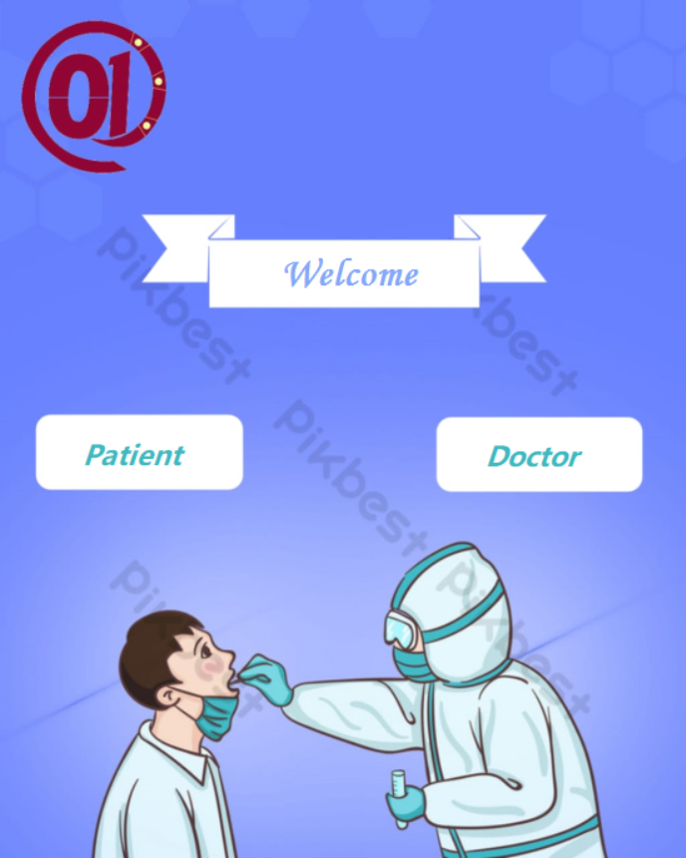
Home Form
User when open The Application. This form will be appeared where choose his role doctor or patient.

Slide 6
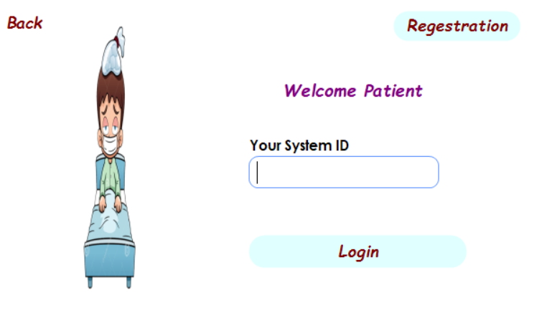
Login Form for patient
Patient enters his System ID to login.
Or go to registration if he is new

Slide 7
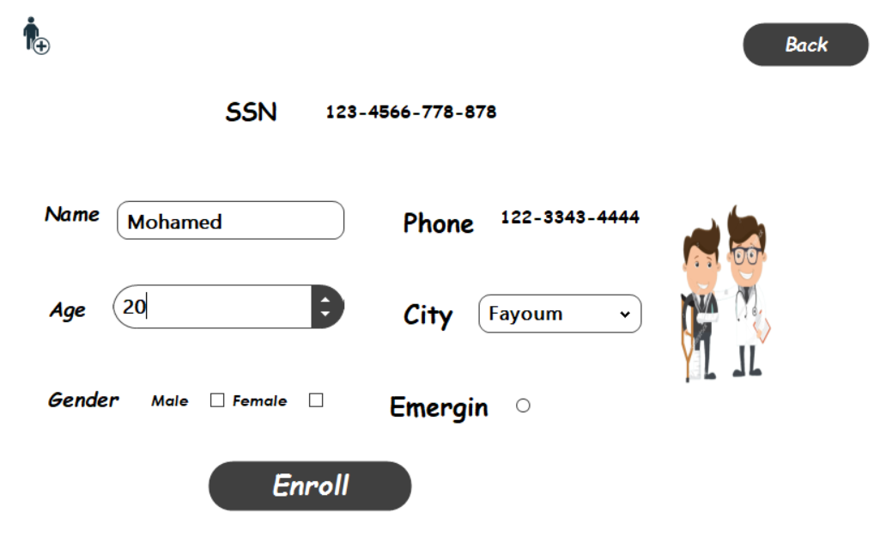
Registration Form for patient
User enters his data to register and then app go to login form for patient

Slide 8
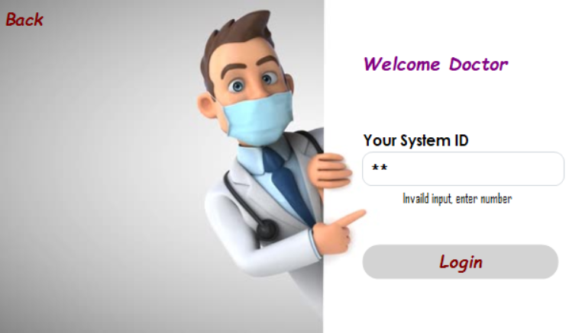
Login Form for Doctor
Doctor enters his System ID to login.
Then go to Doctor Form
Manager has tow options login as doctor or as manager (go to manager form)

Slide 9
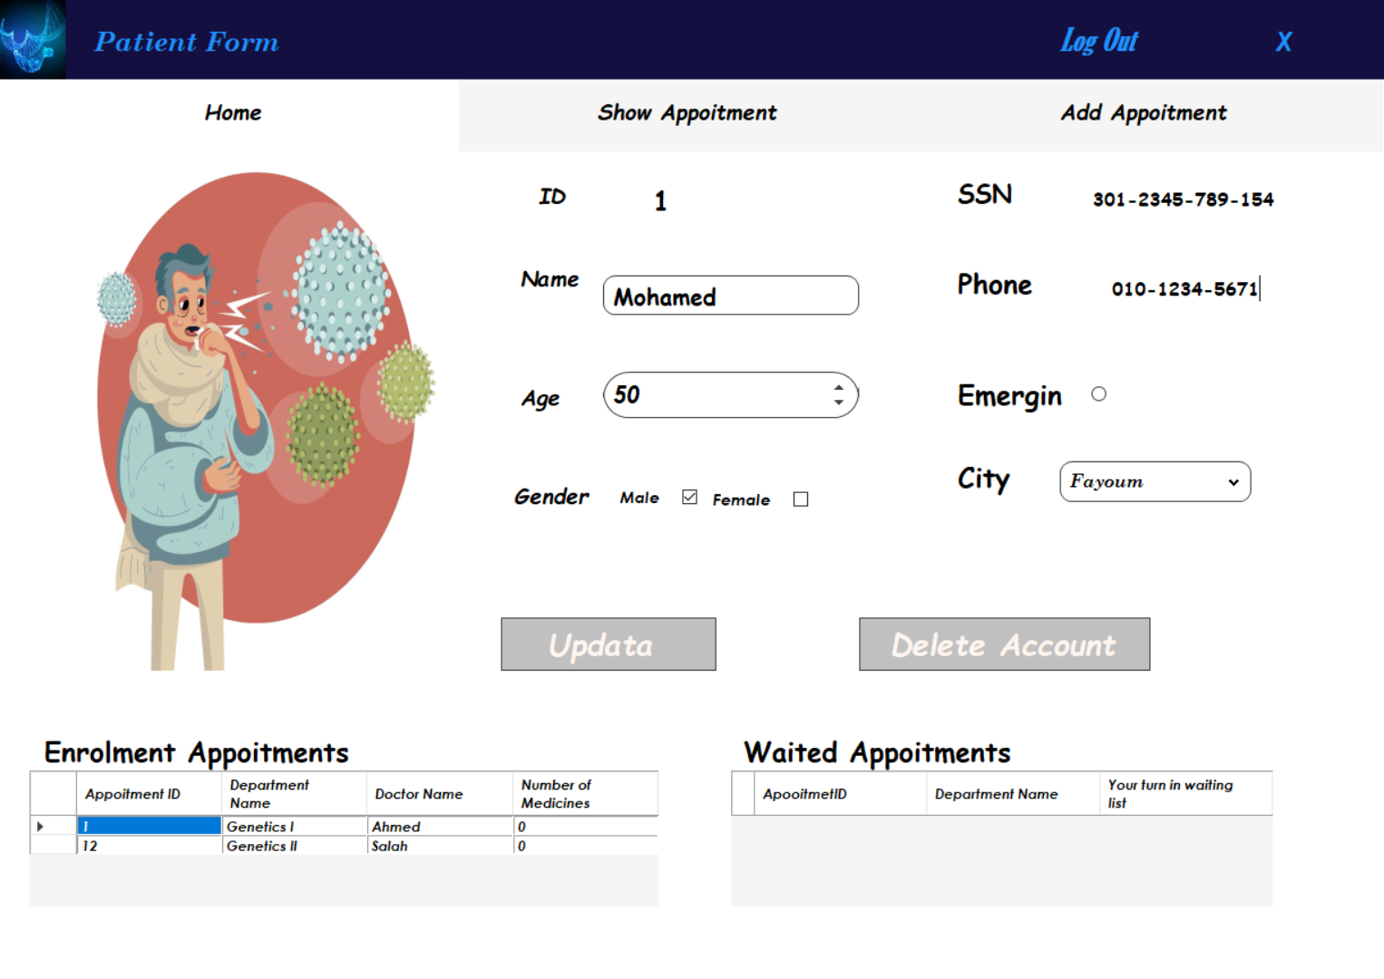
Form for Patient Home Tap
Patient can edit hi data and remove his account
Show his appointment
Can remove waited appointment when select on it
When he select in enrolment appointment, go to show appointment tap

Slide 10
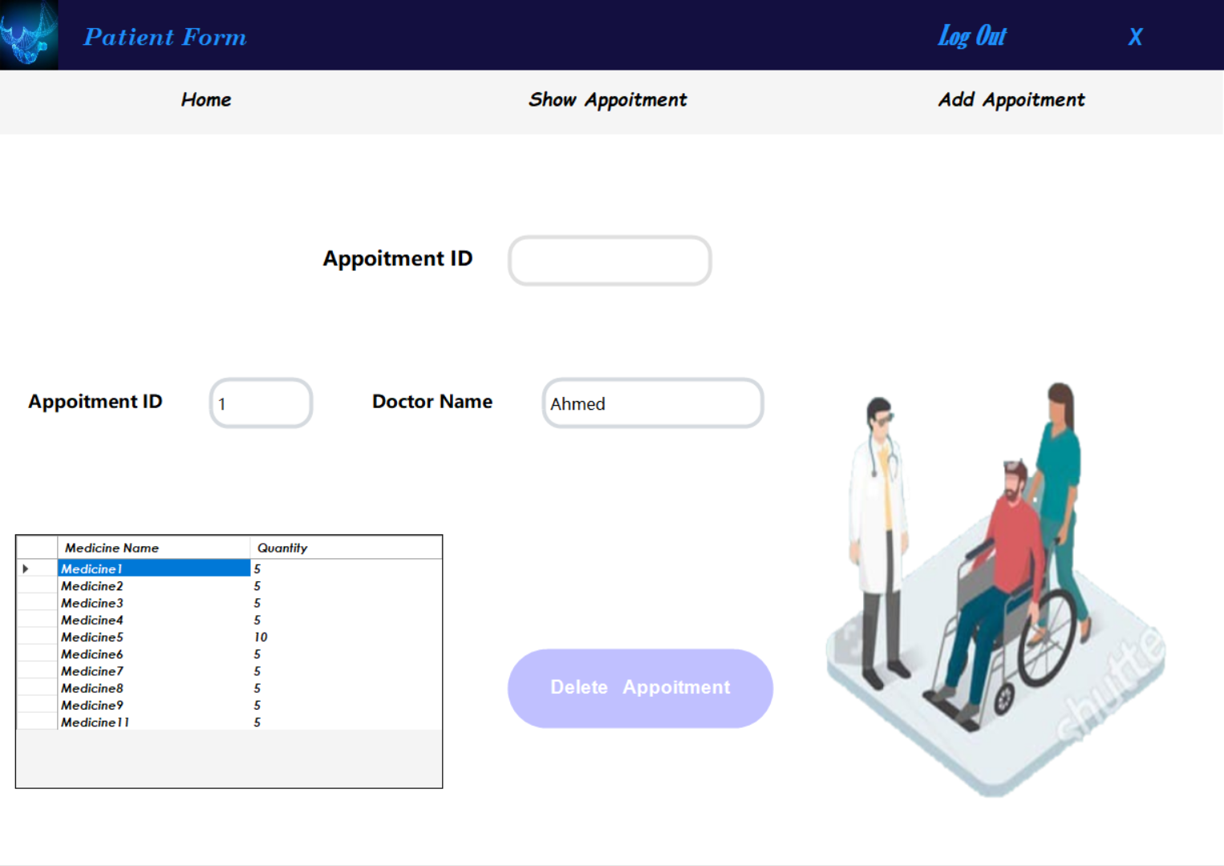
Form for Patient Show Tap
Patient can search about his appointment
Can remove appointment
Only show his medicines

Slide 11
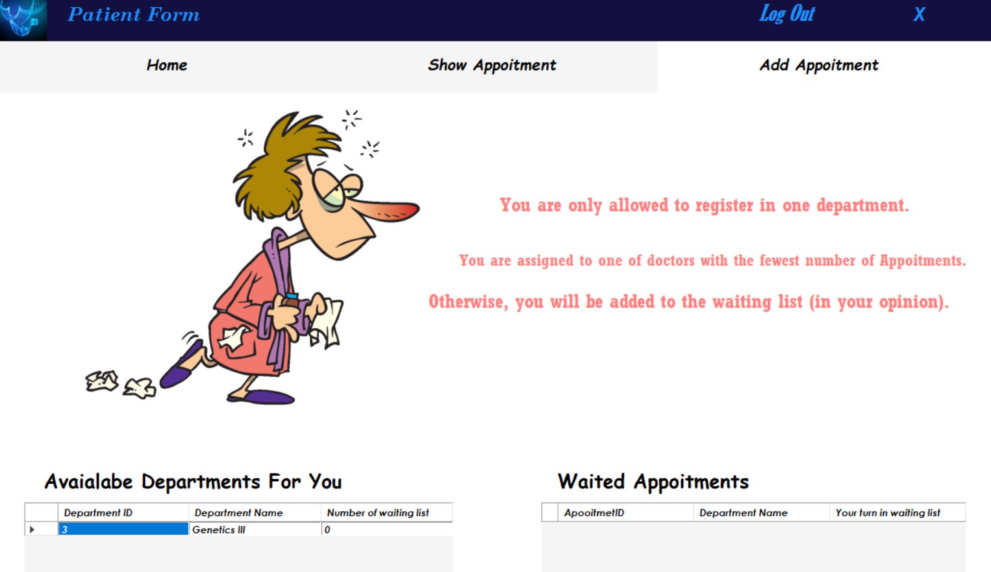
Form for Patient Add Appointment Tap
Patient can add new appointment ,
If Department is not available, can add to waiting list

Slide 12
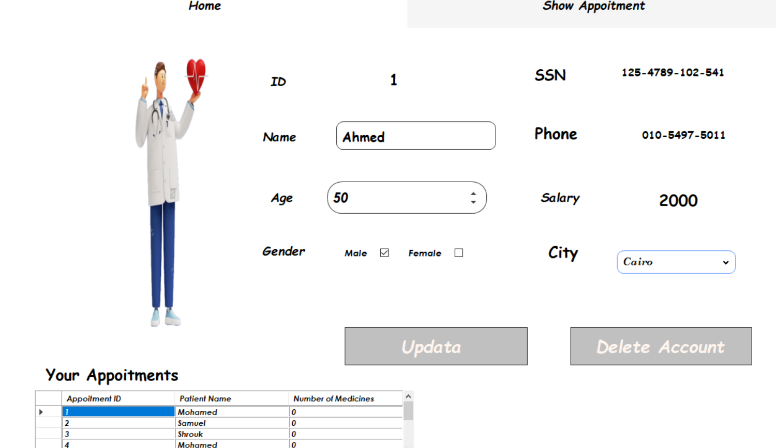
Form for Doctor Home Tap
Doctor can edit hi data and remove his account
Show his appointment
When he select in appointment, go to show appointment tap

Slide 13
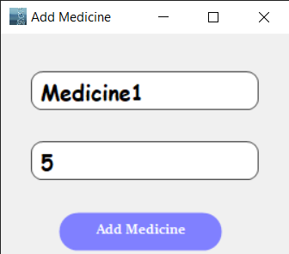
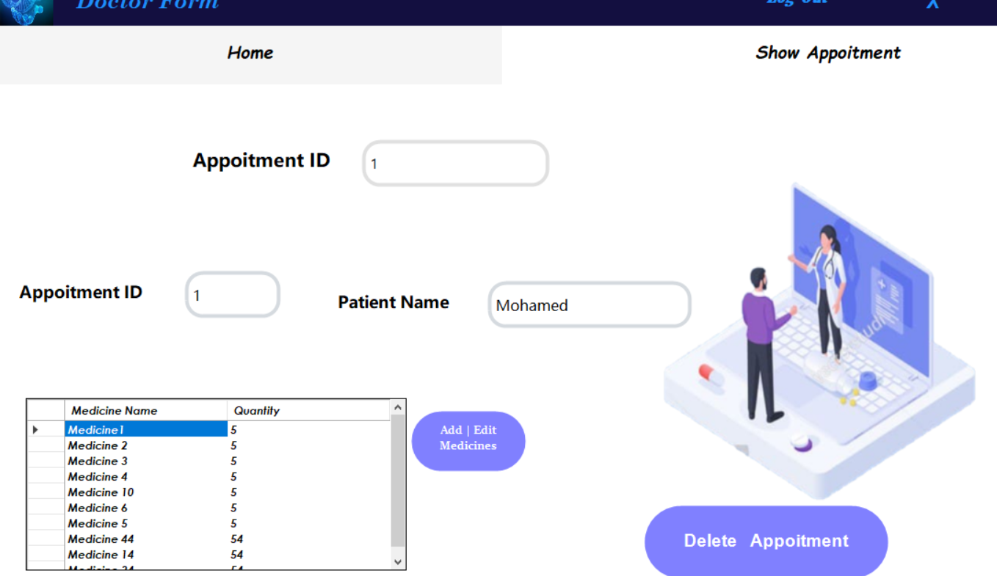
Form for Doctor Show Appointment Tap
Doctor can search about his appointment
Can remove appointment
show appointment medicines and remove / edit / delete medicine

Slide 14
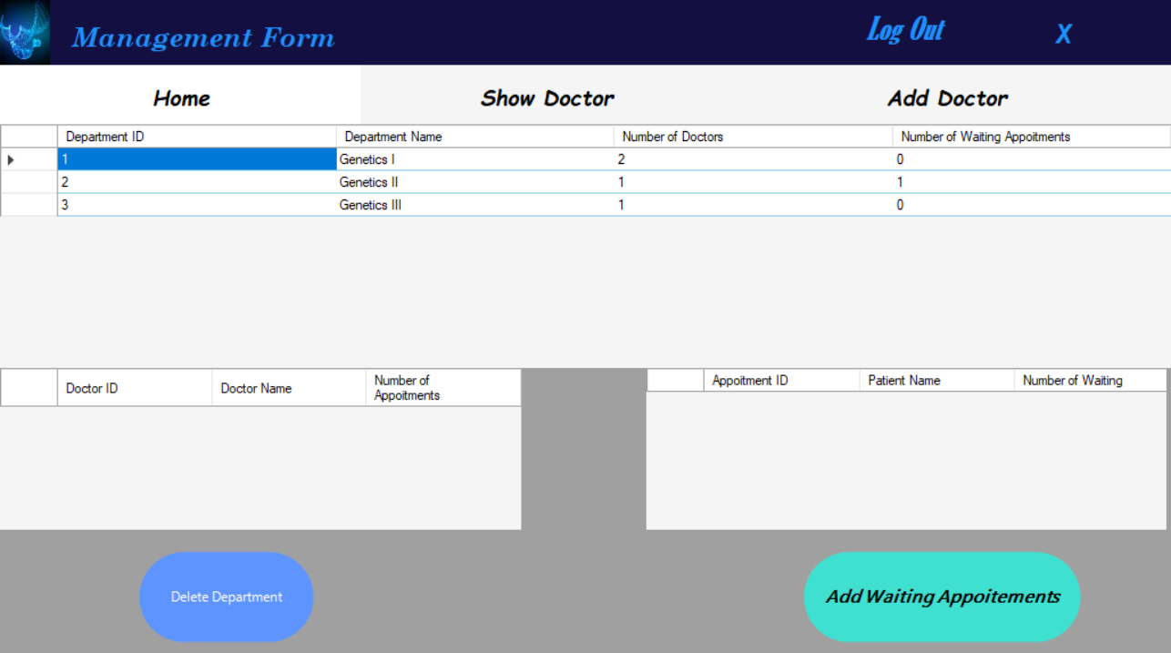
Form for Manager Home Tap
Manager can show all departments data
When select department its data show bellow
Can delete department
Assign waiting appointments to available doctors

Slide 15
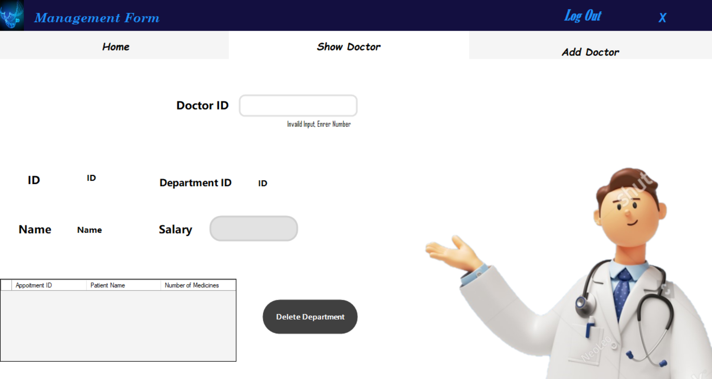
Form for Manager Show Doctor Tap
Show doctor data and remove him.

Slide 16
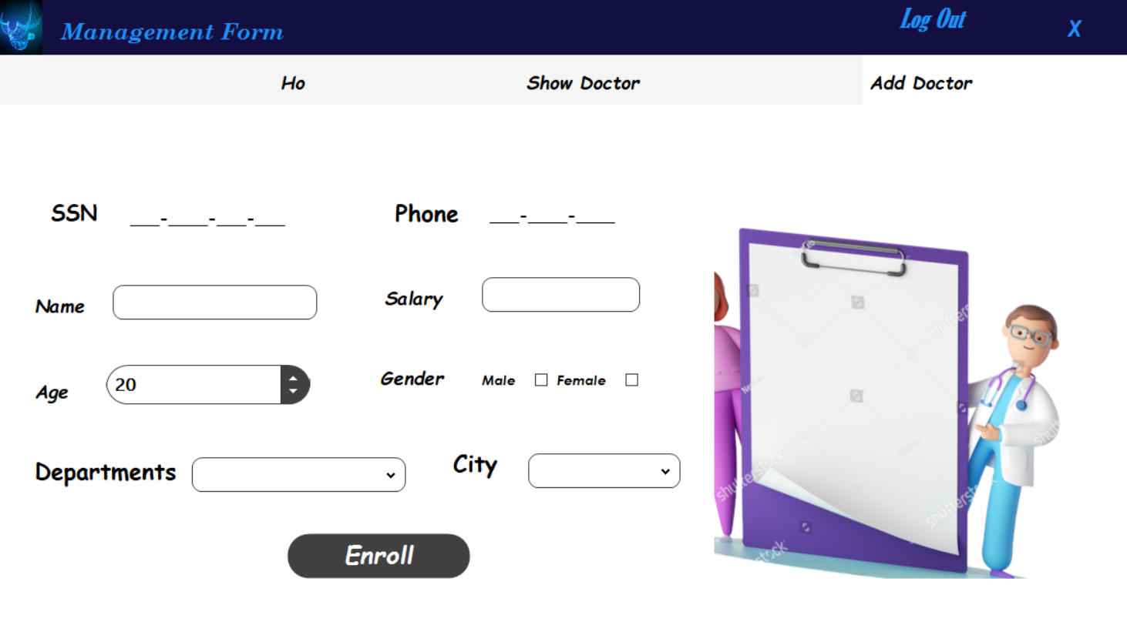
Form for Manger Add new Doctor Tap
Add new Doctor. Only main info

